Slide 1
UPPER SIXTH ARTS
GEOGRAPHY
Field Work 3
Fieldwork in Hydrology: Running Water
Notes:
Good morning, class, and welcome to our geography lesson. I am your geography teacher, Mr Kamdem. Today we are starting Field Work 3: Fieldwork in Hydrology: Running Water.

Slide 2
CLASS INFO
Class, Chapter and Duration
Class | Upper Sixth Arts
Chapter | Module 8: Understanding and carrying out statistical techniques, topographic map analysis, fieldwork and project based learning
Duration | 2 periods (2 × 50 minutes)
Notes:
This lesson is for Upper Sixth Arts. It belongs to Module 8: Understanding and carrying out statistical techniques, topographic map analysis, fieldwork and project based learning. We shall need 2 periods to cover it.

Slide 3
IDENTIFICATION
Lesson Identification
Topic | Fieldwork in Geography
Sub-topic | Field investigations in physical geography
Lesson | Field Work 3: Fieldwork in Hydrology: Running Water
Notions / Concepts | Channel width, depth, velocity, discharge, load, roundness, gully, sheet erosion.
Syllabus focus | Stream channel processes and characteristics; load characteristics; channel form with distance; stream, gully or sheet erosion.
Competence | Learners are able to measure channel characteristics and load and relate them to distance downstream.
Notes:
Our topic is Fieldwork in Geography, and the sub-topic is Field investigations in physical geography. The key notions we shall use today are: channel width, depth, velocity, discharge, load, roundness, gully, sheet erosion. At the end, you should be able to do this: learners are able to measure channel characteristics and load and relate them to distance downstream.

Slide 4

HOMEWORK CORRECTION
Correction of the Homework
Question (Field Work 1: Getting Geographical Coordinates):
Record the coordinates of five places in your neighbourhood with a phone and plot them on a sketch.
Notes:
Before we start the new lesson, let us correct the homework I gave you at the end of Field Work 1: Getting Geographical Coordinates. The question was: Record the coordinates of five places in your neighbourhood with a phone and plot them on a sketch. Take out your exercise books.

Slide 5
HOMEWORK CORRECTION
Correction: Possible Answer
Answers vary. Example: school 9.30° N, 13.40° E; market 9.31° N, 13.39° E. Plot each point on a grid sketch with latitude on the y-axis and longitude on the x-axis.
Notes:
Here is a good answer. Answers vary. Example: school 9.30° N, 13.40° E; market 9.31° N, 13.39° E. Plot each point on a grid sketch with latitude on the y-axis and longitude on the x-axis. Compare it with your own answer and correct your work in red.

Slide 6
LESSON PLAN
Lesson Plan
Correction of the homework
Objectives and recall
Real-life situation and action to take
Learning activities
Board summary
Evaluation, remediation and homework
Notes:
Here is the plan of our lesson today. First, we shall correct the homework. Then we shall look at the objectives and recall what you already know. After that, we shall study a situation from real life and the action to take, and do the learning activities. Finally, we shall copy the board summary, do the evaluation and the remediation, and I will give you the homework.

Slide 7
OBJECTIVES
Objectives
By the end of this lesson, you should be able to:
Measure width, depth and velocity of a stream.
Calculate discharge and analyse load size and shape.
Notes:
Take your time to copy this part; we will continue together.

Slide 8
OBJECTIVES
Objectives (continued)
Observe and record erosion features.
Notes:
By the end of this lesson, you should be able to do three things. Number 1: measure width, depth and velocity of a stream. Number 2: calculate discharge and analyse load size and shape. Number 3: observe and record erosion features.

Slide 9
PREVIOUS KNOWLEDGE
Previous Knowledge
Rivers erode, transport and deposit.
Discharge = area × velocity.
Notes:
Let us first remember what you already know. Rivers erode, transport and deposit. Discharge = area × velocity. Keep this in mind, because we shall build on it today.

Slide 10
REAL-LIFE SITUATION
Situation in Real Life
The class plans to study a small stream near the school at four sites from upstream to downstream. Their hypothesis is: "Channel width, depth and discharge increase downstream."
Notes:
Listen carefully to this situation from real life. The class plans to study a small stream near the school at four sites from upstream to downstream. Their hypothesis is: "Channel width, depth and discharge increase downstream." Think about it, because I am going to ask you some questions.

Slide 11
REAL-LIFE SITUATION
Situation: Question 1
What is the problem in the situation?
Notes:
Question 1: What is the problem in the situation? Think for a moment, then raise your hand to answer.

Slide 12
REAL-LIFE SITUATION
Answer
The class must test a hypothesis on a stream.
Notes:
Good. The class must test a hypothesis on a stream.

Slide 13
REAL-LIFE SITUATION
Situation: Question 2
What will they measure?
Notes:
Question 2: What will they measure? Think for a moment, then raise your hand to answer.

Slide 14
REAL-LIFE SITUATION
Answer
Width, depth, velocity and load.
Notes:
Good. Width, depth, velocity and load.

Slide 15
REAL-LIFE SITUATION
Situation: Question 3
How is discharge calculated?
Notes:
Question 3: How is discharge calculated? Think for a moment, then raise your hand to answer.

Slide 16
REAL-LIFE SITUATION
Possible Answer
Cross-section area × velocity.
Notes:
Good. Cross-section area × velocity.

Slide 17
ACTION TO TAKE
Action to Take
Follow the steps of fieldwork and respect safety rules near water.
Notes:
From this situation, the action we are working towards in this lesson is the following: follow the steps of fieldwork and respect safety rules near water.

Slide 18
JUSTIFICATION
Justification of the Lesson
This fieldwork helps us to observe river processes directly.
Notes:
Why is this lesson important for you? This fieldwork helps us to observe river processes directly.

Slide 19

1. PLANNING
Activity 1
Steps of a field investigation.
Notes:
Activity 1. Look carefully at this diagram: steps of a field investigation. Observe every detail before I ask the question.

Slide 20
1. PLANNING
Activity 1: Question
Write a hypothesis for a stream study.
Notes:
Here is the question for Activity 1: Write a hypothesis for a stream study. Take one minute to think and write your answer in your rough notebook.

Slide 21
1. PLANNING
Activity 1: Answer
"Discharge increases downstream" (or "pebbles get smaller downstream").
Notes:
Let us check the answer together. "Discharge increases downstream" (or "pebbles get smaller downstream").

Slide 22
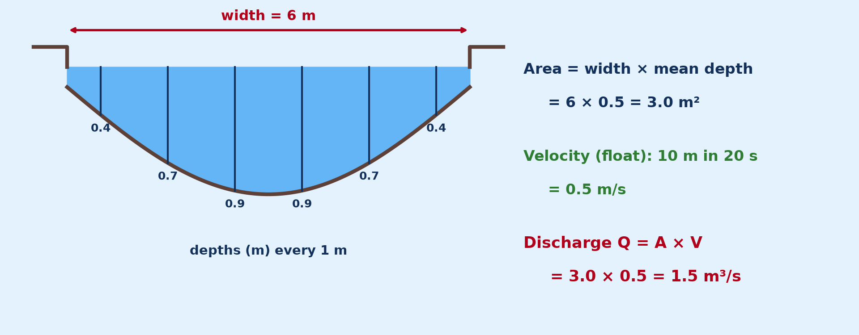
2. CHANNEL MEASUREMENT
Activity 2
Measuring a channel.
Notes:
Activity 2. Look carefully at this diagram: measuring a channel. Observe every detail before I ask the question.

Slide 23
2. CHANNEL MEASUREMENT
Activity 2: Question
Width 6 m, mean depth 0.5 m, velocity 0.5 m/s. Find discharge.
Notes:
Here is the question for Activity 2: Width 6 m, mean depth 0.5 m, velocity 0.5 m/s. Find discharge. Take one minute to think and write your answer in your rough notebook.

Slide 24
2. CHANNEL MEASUREMENT
Activity 2: Answer
6 × 0.5 × 0.5 = 1.5 m³/s.
Notes:
Let us check the answer together. 6 × 0.5 × 0.5 = 1.5 m³/s.

Slide 25
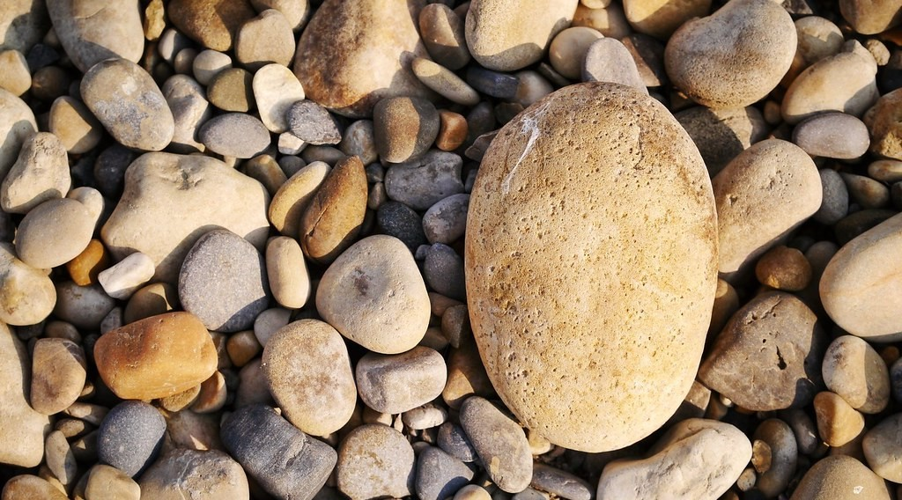
2. LOAD SAMPLING
Activity 3
Pebbles of different sizes and shapes.
Notes:
Activity 3. Look carefully at this picture: pebbles of different sizes and shapes. Observe every detail before I ask the question.

Slide 26
2. LOAD SAMPLING
Activity 3: Question
How do you sample pebbles at each site?
Notes:
Here is the question for Activity 3: How do you sample pebbles at each site? Take one minute to think and write your answer in your rough notebook.

Slide 27
2. LOAD SAMPLING
Activity 3: Answer
Pick 10 pebbles at random, measure their long axis and score their roundness.
Notes:
Let us check the answer together. Pick 10 pebbles at random, measure their long axis and score their roundness.

Slide 28
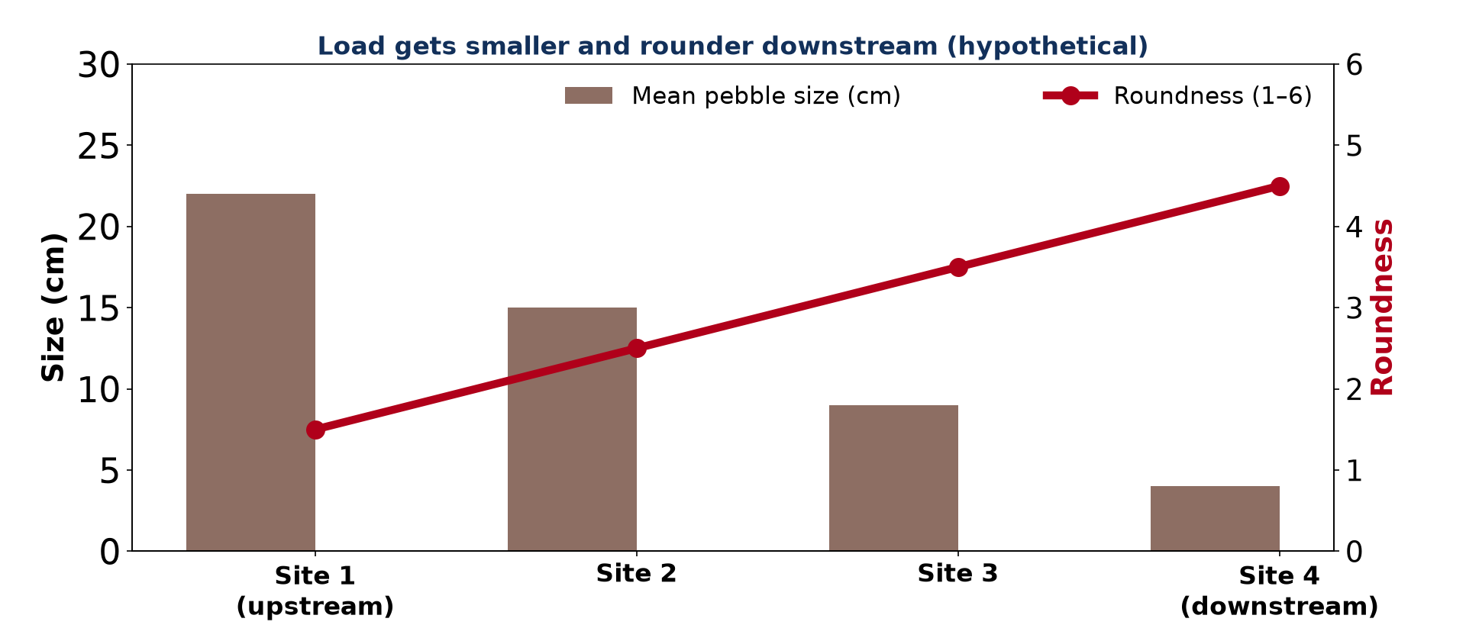
3. LOAD CHARACTERISTICS
Activity 4
Load size and roundness downstream.
Notes:
Activity 4. Look carefully at this diagram: load size and roundness downstream. Observe every detail before I ask the question.

Slide 29
3. LOAD CHARACTERISTICS
Activity 4: Question
Why do pebbles become smaller and rounder downstream?
Notes:
Here is the question for Activity 4: Why do pebbles become smaller and rounder downstream? Take one minute to think and write your answer in your rough notebook.

Slide 30
3. LOAD CHARACTERISTICS
Activity 4: Answer
Attrition and abrasion wear them down as they are transported.
Notes:
Let us check the answer together. Attrition and abrasion wear them down as they are transported.

Slide 31

4. EROSION
Activity 5
Gully erosion.
Notes:
Activity 5. Look carefully at this picture: gully erosion. Observe every detail before I ask the question.

Slide 32
4. EROSION
Activity 5: Question
How can you record gully erosion in the field?
Notes:
Here is the question for Activity 5: How can you record gully erosion in the field? Take one minute to think and write your answer in your rough notebook.

Slide 33
4. EROSION
Activity 5: Answer
Measure its width and depth, take photos and note the slope and vegetation.
Notes:
Let us check the answer together. Measure its width and depth, take photos and note the slope and vegetation.

Slide 34
BOARD SUMMARY
Board Summary
Topic: Fieldwork in Geography
Sub-topic: Field investigations in physical geography
Field Work 3: Fieldwork in Hydrology: Running Water
Notes:
Now we are going to copy the board summary. Write the title and the headings neatly in your notebooks. I will give you enough time for each slide, so do not rush.

Slide 35
BOARD SUMMARY
1. Planning a Stream Investigation
A stream study is planned as follows:
Hypothesis: It is a statement to be tested, such as "discharge increases downstream". Sites are chosen at equal intervals along the stream.
Notes:
Let us copy Planning a Stream Investigation. A stream study is planned as follows. On this slide we have Hypothesis. Write each point on a new line, with the key term first, and explain it in your own words when we revise. When you finish, we go to the next slide.

Slide 36
BOARD SUMMARY
1. Planning a Stream Investigation (continued)
Safety and equipment: Work in groups, avoid deep or fast water and wear boots. Take tapes, metre rulers, floats, a stopwatch and recording sheets.
Notes:
We continue with Planning a Stream Investigation. On this slide we have Safety and equipment. Write each point on a new line, with the key term first, and explain it in your own words when we revise.

Slide 37
BOARD SUMMARY
2. Stream Channel Characteristics
The channel is measured as follows:
Width and depth: Width is measured across the water surface with a tape. Depth is measured at regular intervals and averaged.
Velocity and discharge: Velocity is found by timing a float over 10 m. Discharge = width × mean depth × velocity (m³/s).
Notes:
Let us copy Stream Channel Characteristics. The channel is measured as follows. On this slide we have Width and depth and Velocity and discharge. Write each point on a new line, with the key term first, and explain it in your own words when we revise. When you finish, we go to the next slide.

Slide 38
BOARD SUMMARY
2. Stream Channel Characteristics (continued)
Channel form with distance: Width, depth and discharge usually increase downstream. Results are shown on graphs and explained by tributaries and erosion.
Notes:
We continue with Stream Channel Characteristics. On this slide we have Channel form with distance. Write each point on a new line, with the key term first, and explain it in your own words when we revise.

Slide 39
BOARD SUMMARY
2. Stream Channel Characteristics
Illustration: measuring a channel
Notes:
Now draw this illustration in your notebook: measuring a channel. Give it a title and label it clearly.

Slide 40
BOARD SUMMARY
3. Load and Erosion
Load and erosion are studied as follows:
Load characteristics: Ten pebbles are sampled at random at each site, measured on the long axis and scored for roundness. They usually become smaller and rounder downstream by attrition.
Notes:
Let us copy Load and Erosion. Load and erosion are studied as follows. On this slide we have Load characteristics. Write each point on a new line, with the key term first, and explain it in your own words when we revise. When you finish, we go to the next slide.

Slide 41
BOARD SUMMARY
3. Load and Erosion (continued)
Stream, gully or sheet erosion: Gullies are measured for width and depth, photographed and described. Slope and plant cover are noted to explain the erosion.
Notes:
We continue with Load and Erosion. On this slide we have Stream, gully or sheet erosion. Write each point on a new line, with the key term first, and explain it in your own words when we revise.

Slide 42
BOARD SUMMARY
3. Load and Erosion
Illustration: load size and roundness downstream
Notes:
Now draw this illustration in your notebook: load size and roundness downstream. Give it a title and label it clearly.

Slide 43
FORMATIVE EVALUATION
Evaluation 1
Float travels 10 m in 25 s. Find velocity.
Notes:
Now let us check what you have understood. Question 1: Float travels 10 m in 25 s. Find velocity. Answer in your exercise book.

Slide 44
FORMATIVE EVALUATION
Expected Answer
10 ÷ 25 = 0.4 m/s.
Notes:
The expected answer is: 10 ÷ 25 = 0.4 m/s. If you got it right, well done.

Slide 45
FORMATIVE EVALUATION
Evaluation 2
Give two expected changes downstream.
Notes:
Now let us check what you have understood. Question 2: Give two expected changes downstream. Answer in your exercise book.

Slide 46
FORMATIVE EVALUATION
Expected Answer
Discharge increases; pebbles get smaller.
Notes:
The expected answer is: discharge increases; pebbles get smaller. If you got it right, well done.

Slide 47
REMEDIATION
Remediation
Fill in the blanks:
Q = area × ______.
Wearing down of pebbles is ______.
Velocity is measured with a ______.
Notes:
For those who need more practice, fill in the blanks in your exercise book. The answers are: number 1, velocity; number 2, attrition; number 3, float.

Slide 48
HOMEWORK
Homework
Prepare a recording sheet for width, depth, velocity and pebble size at four sites.
Notes:
For your homework: Prepare a recording sheet for width, depth, velocity and pebble size at four sites. We shall correct it at the beginning of our next lesson.

Slide 49
NEXT LESSON
Next Lesson
Our next lesson will be on:
Field Work 4: Fieldwork in Geomorphology: Rivers and Coasts
Notes:
Our next lesson will be on Field Work 4: Fieldwork in Geomorphology: Rivers and Coasts. Thank you for your attention, and see you next time.

Slide 50
BILINGUAL GAME
Bilingual Game (Jeu Bilingue)
English | Français
Stream | Le ruisseau
Width | La largeur
Depth | La profondeur
Velocity | La vitesse
Discharge | Le débit
Pebble | Le galet
Notes:
Let us play the bilingual game. I say a word in English, and you give me the French word. Then we do the reverse.

Slide 51
LOGBOOK
Official Logbook (1/2)
Module / Topic | Fieldwork in Geography
Lesson Title | Field Work 3: Fieldwork in Hydrology: Running Water
Expected Learning Outcomes | Measure width, depth and velocity of a stream. Calculate discharge and analyse load size and shape. Observe and record erosion features.
Competence | Learners are able to measure channel characteristics and load and relate them to distance downstream.
Notes:
I record this information in the official logbook of the class after the lesson.

Slide 52
LOGBOOK
Official Logbook (2/2)
Matter Taught | Planning a Stream Investigation; Stream Channel Characteristics; Load and Erosion.
Evaluation | Formative evaluation and remediation exercise.
Homework | Prepare a recording sheet for width, depth, velocity and pebble size at four sites.
Enrolment / Present / Absent | ____ / ____ / ____
Achievement | To be completed after the lesson.
Notes:
I complete the second page of the logbook: the matter taught, the evaluation, the homework and the attendance.

Slide 53
TEACHER'S NOTE
Teacher's Note
Timing: Homework correction, plan, objectives 8 min | Recall, situation, action 10 min | 5 activities 30 min | Board summary (copying) 30 min | Evaluation, remediation 10 min | Homework, next lesson 5 min | Logbook 7 min
Without the projector (Activity 1): write hypotheses.
Without the projector (Activity 2): calculate discharge.
Without the projector (Activity 3): describe the method.
Without the projector (Activity 4): explain the graph.
Without the projector (Activity 5): record a gully.
Notes:
This slide is for me, the teacher: it gives the timing of the lesson and what to do if the projector is not available.

Slide 54
REFERENCES
References
National Geography Syllabus, MINESEC/IGE/IP-SS, 2019 — Module 8 (Practical Geography).
Photo, Activity 3: “Pebbles” by Squidz, CC BY-ND 2.0, via Flickr (https://www.flickr.com/photos/49186419@N00/8046011884)
Photo, Activity 5: “Soil erosion in the central Mexican Highlands” by CIMMYT, CC BY-NC-SA 2.0, via Flickr (https://www.flickr.com/photos/44760652@N05/6244930288)
Diagrams and animations: drawn for this lesson (Geography Department).
Notes:
These are the references and picture credits used to prepare this lesson.

